Slide 1



Validating time-to-event clinical prediction models: a case study in ANCA-associated glomerulonephritis
Sebastian Bate^{1,2} and Silke R Brix^{3,4} on behalf of the ANCA PRISMA Group
sgbstats/ANCA-Public
@sebastianbate
¹Manchester Academic Health Science Centre, Research and Innovation, Manchester University NHS Foundation Trust, Manchester, UK
²Centre for Biostatistics, Division of Population Health, Health Services Research, and Primary Care, University of Manchester, Manchester, UK
³Division of Cardiovascular Sciences, School of Medical Sciences, University of Manchester, Manchester, UK
⁴Renal, Transplantation and Urology Unit, Manchester University NHS Foundation Trust, Manchester, UK

Slide 2
The ANCA case study
Anti-neutrophil cytoplasmic antibody (ANCA)-associated vasculitides (AAV) are autoimmune disorders characterized by inflammation of small blood vessels resulting in irreversible organ damage.
Renal involvement is very common
Disease presentation is heterogeneous
UK incidence of 23 per million per year [Pearce, 2016]
~20% end up in ESKD
There is an array of tools for predicting outcome but there has been a lack of validation due to the disease’s rarity.

Slide 3
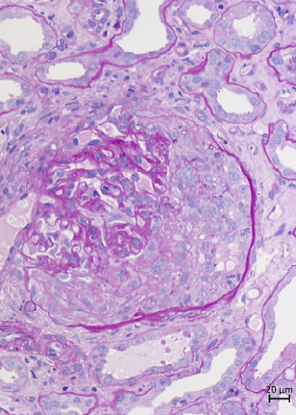
The Renal Risk Score
[Brix, 2018] developed a novel scoring system for risk of end stage kidney disease in a German prospective cohort (110 development, 90 validation)
3 Components
Estimated glomerular filtration rate (</>15ml/min/1.73m²)
Percentage of normal glomeruli (<10%,10-25%,>25%)
Percentage of interstitial fibrosis and tubular atrophy (</>25%)
Points and risk groups assigned

Slide 4











The case study: ANCA REFINE
Aims:
Validate the original score
Refine the score/develop a new model
Do it properly
Design:
International multicentre longitudinal retrospective cohort study
Up to 20 years of F/U
1439 patients met the IC/EC (biggest cohort ever!!)
2:1 random dev:val split

Slide 5
Problems in prediction
There are a lot of prediction models
Including 1382 for cardiovascular disease, 408 for COPD, 363 for incident CVD, 263 for obstetrics, 232 for Covid-19: the list goes on [Collins, 2022]
There is a lot of flawed modelling

Slide 6
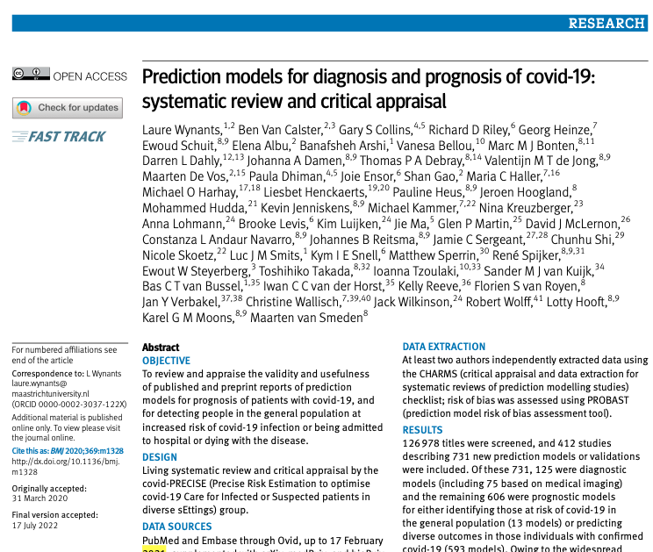
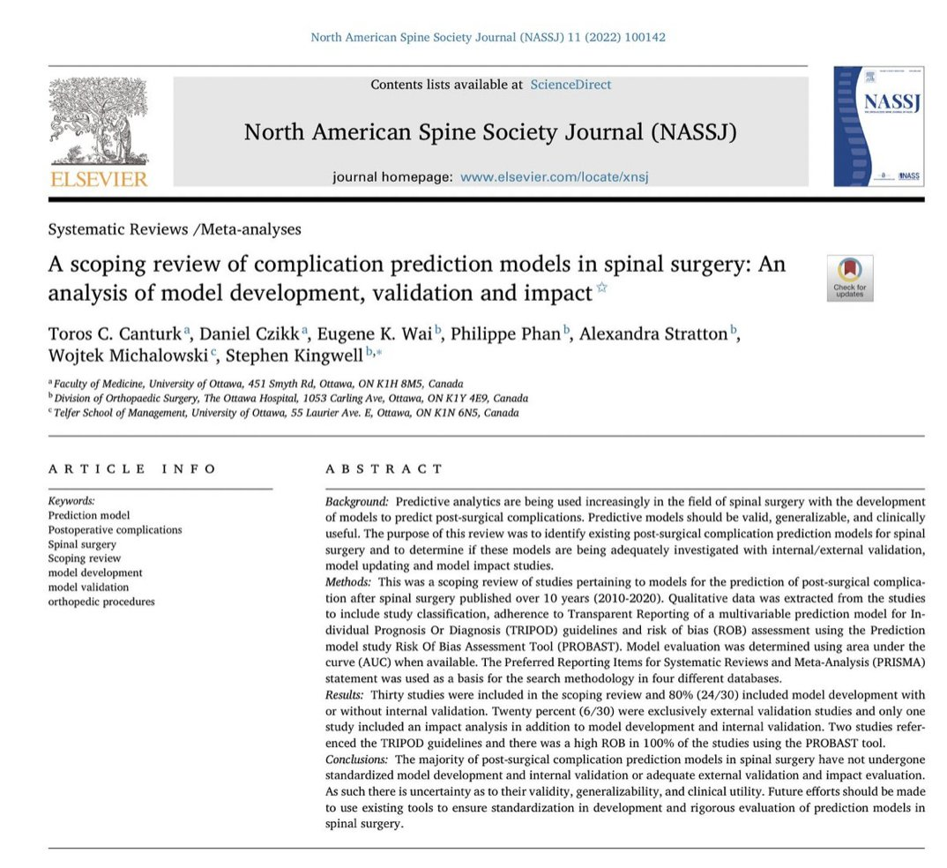
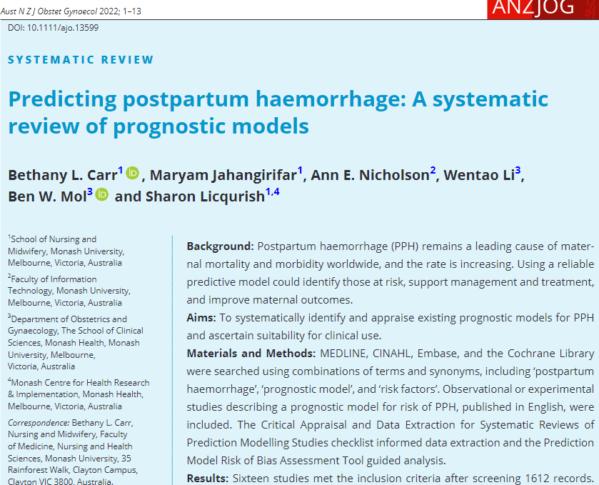
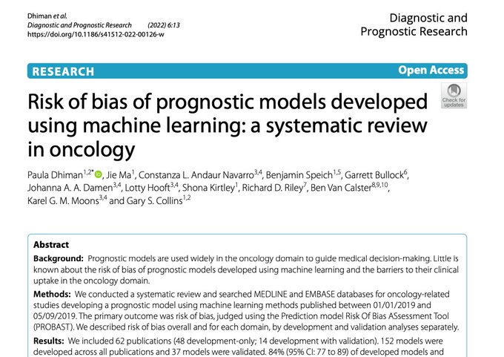
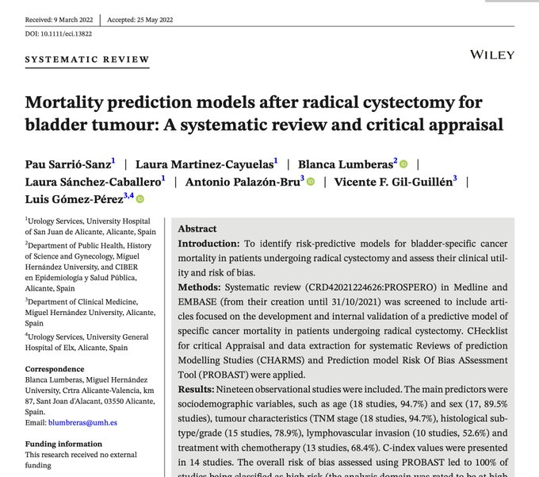
Poor quality methods and reporting leads to a lack of replicability and high risk of bias.
[Canturk, 2022; Sarrió-Sanz, 2022; Dhiman, 2022; Carr, 2022; Wynants, 2020]

Slide 7
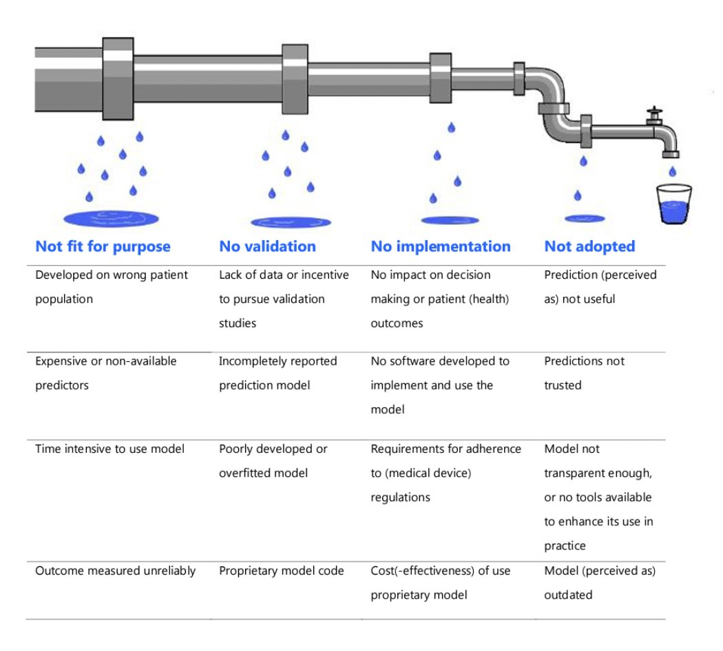
Today’s focus from the leaky pipeline of prognostic modelling
[van Royen, 2022]

Slide 8
Why is survival harder than binary?
Right censoring
HR is the average extra risk over the lifetime of the study
Multiple timepoints

Slide 9
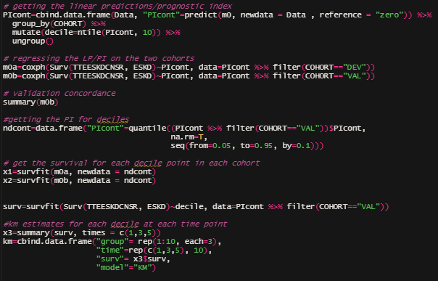
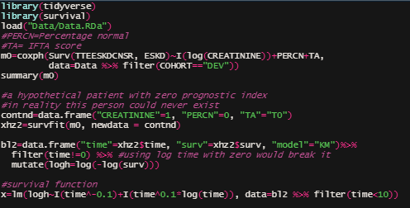
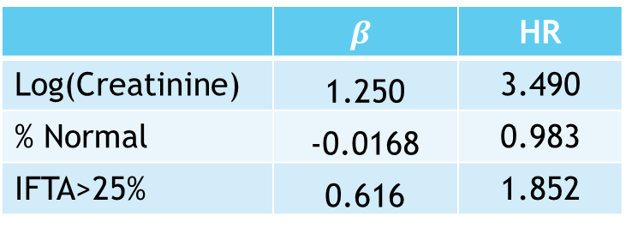
Overview of methods
 | $$β$$ | HR
Log(Creatinine) | 1.250 | 3.490
% Normal | -0.0168 | 0.983
IFTA>25% | 0.616 | 1.852
Using [Royston and Altman, 2013]
Fit new model
Fit baseline survival function
Generate predictions
Test predictions
There is a load of ggplot code below

Slide 10
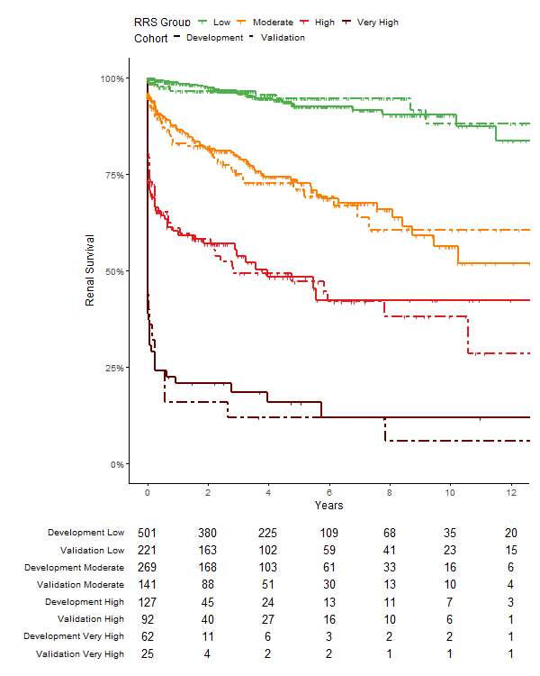
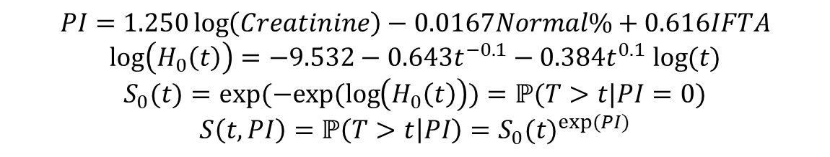
Results
Original score: C=0.800 (due to incomplete reporting we can’t do a full calibration)
New Continuous Model: C_{Dev}=0.833, C_{Val}=0.815
$$PI=1.250\log\left(Creatinine\right)−0.0167Normal\%+0.616IFTA$$
$$\log\left(H_{0}\left(t\right)\right)=−9.532−0.643t^{−0.1}−0.384t^{0.1} log(t)$$
$$S_{0}(t)=exp(−exp(\log\left(H_{0}\left(t\right)\right))=ℙ(T>t|PI=0)$$
$$S\left(t,PI\right)=ℙ\left(T>t | PI\right)={S_{0}(t)}^{exp(PI)}$$

Slide 11
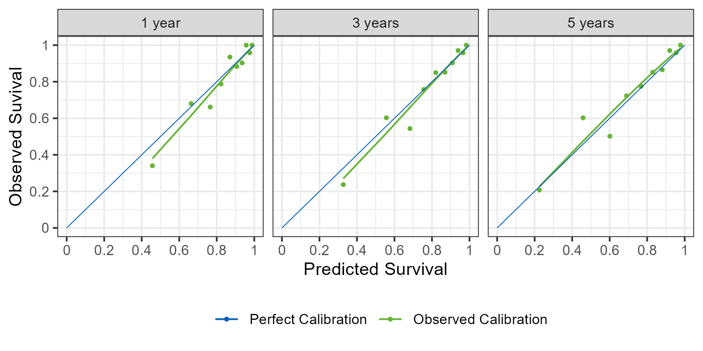
Calibration

Slide 12
Challenges
Currently Stata is better than R for survival 😮
Often methodological help comes with Stata reprex
Generating predictions was a pain
{survival} wasn’t really built for this
Clinical and statistical priorities were not always aligned

Slide 13
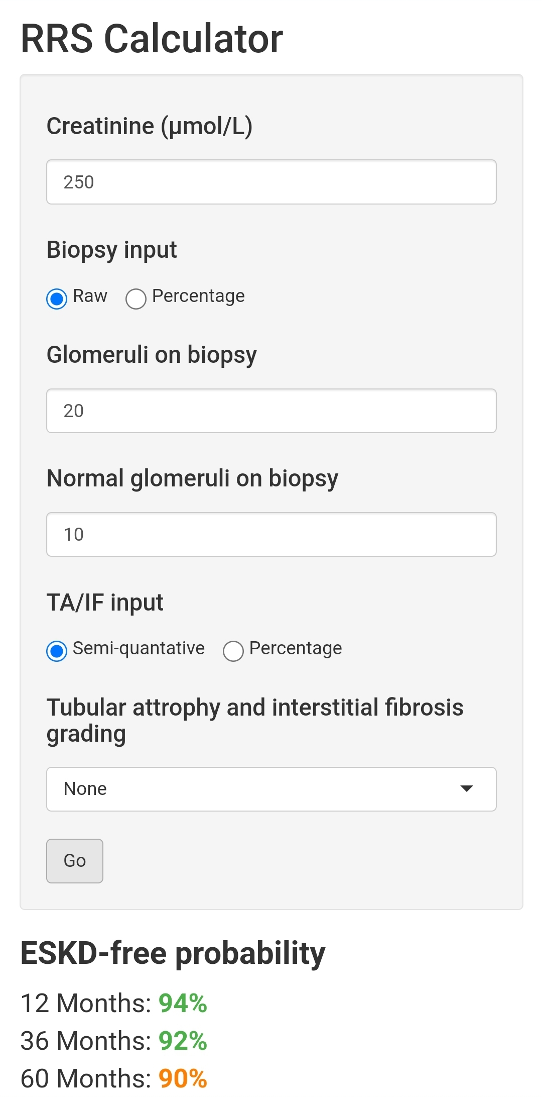
Takeaways
Follow TRIPOD [Collins, 2015; Moons, 2015], even if not publishing in academic circles
Calibrate your models
Publish your coefficients and survival function
Before you ask: yes, there will be a Shiny App

Slide 14
The End
Funding: this project was funded by a Wellcome Trust Translational Partnership Award
ANCA PRISMA group members: Sebastian Bate, Dominic McGovern, Duha Ilyas, Kate Stevens, Jennifer Scott, Gavin Chapman, Eduardo Martin Nares, Arslan Butt, Mehmet Fethullah Aydin, Juan Manuel Mejía Vilet, Abdülmecit Yildiz, Nina Brown, Neeraj Daun, Andrea Hinojosa, Lauren Floyd, Ajay Dhaygude, Marek Myslivecek, Stephen Roberts, Pierre Tennstedt, Eik Vettorazzi, Stephen McAdoo, Vladimir Tesar, Benoit Brilland, Mark Little, Geetha Duruvu, and Silke R Brix.
Centres: Manchester, Salford, Preston, Imperial, Glasgow, Angers, Prague, Uludağ, Johns Hopkins, Mexico City, and the Scottish and Irish registries
References: on GitHub

